Slide 1

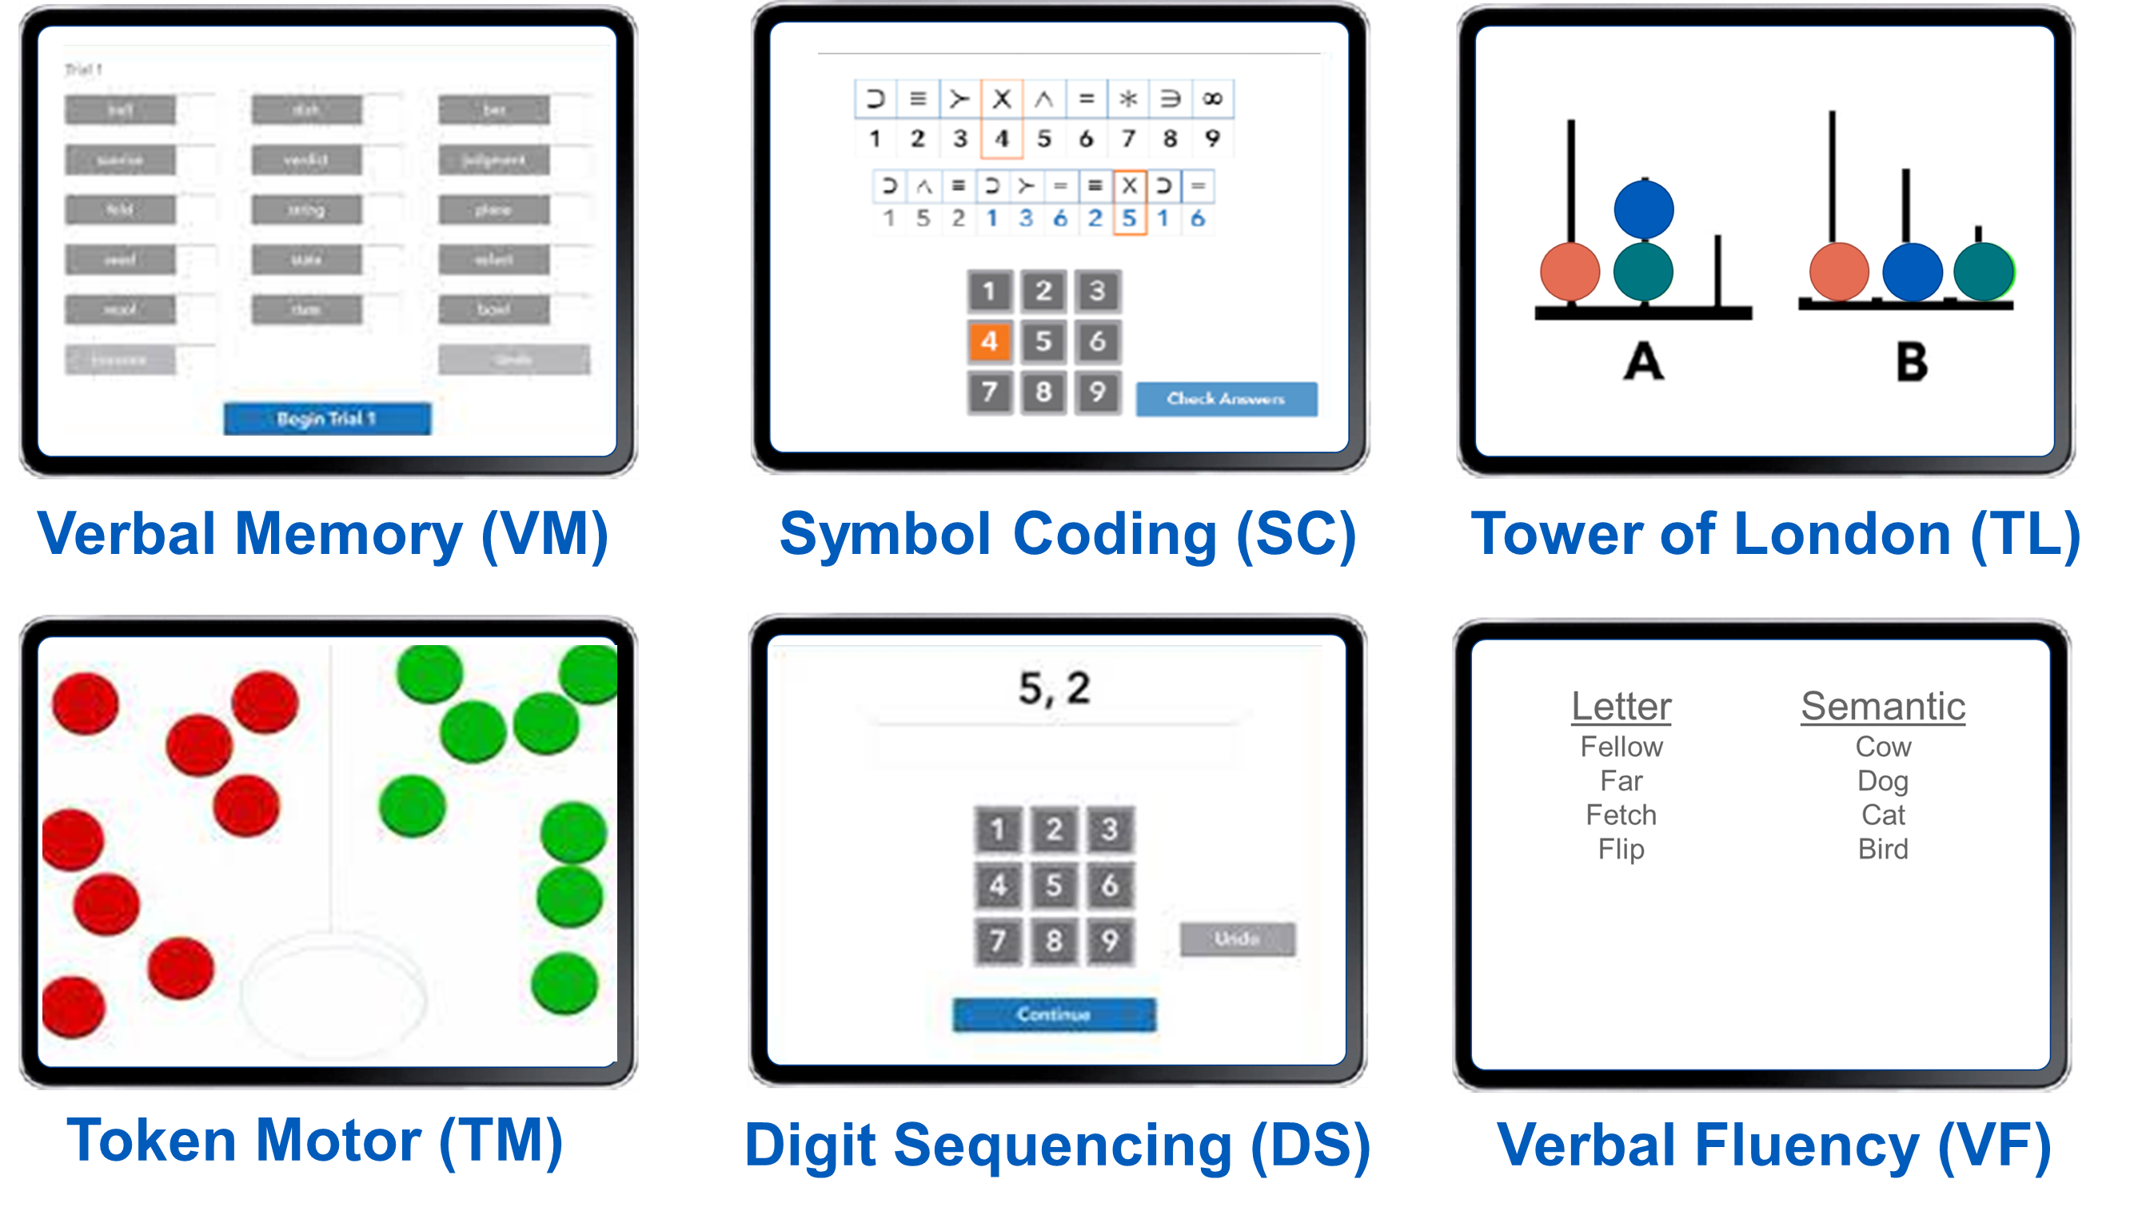
Validation of the Brief Assessment of Cognition (BAC) in multiple sclerosis
Michael Jaworski III, Curtis Wojcik, Margaret Youngs, Mahmut Unverdi, Bianca Weinstock-Guttman, Ralph Benedict
Conclusion: The BAC was found to be a valid and reliable iPad-based battery to assess cognitive function in multiple sclerosis.
BAC App iPad Modules
Introduction
The Brief Assessment of Cognition App (BAC App) is a standardized iPad-platform battery encompassing verbal and visual spatial memory, working memory, processing speed, verbal fluency, executive function, and hand dexterity. The BAC App is mostly automated, requiring less involvement from a technician and less administration time (30 minutes) compared to conventional neuropsychological testing (NPT). The BAC App was previously validated in healthy adults, older adults with cognitive complaints, and individuals with schizophrenia. It is currently unknown if the BAC is valid and reliable in multiple sclerosis (MS).
Verbal Memory (VM)
Digit Sequencing (DS)
Token Motor (TM)
 | VM Total Recall 5-Trials | VM Delayed Free Recall | DS # of Correct Sequences | TM # of Tokens Correctly Placed | SC Number Correct | TL Correct Responses | VST Total Correct Trials
9-Hole Peg Test | -.476** | -.440** | -.424** | -.659** | -.660** | -.500** | -.567**
25 Foot Walk | -.551** | -.534** | -.422** | -.615** | -.710** | -.437** | -.631**
CVLT2 Total Learning | .757** | .664** | .468** | .382** | .579** | .602** | .603**
CVLT2 Delayed Recall | .757** | .714** | .557** | .451** | .669** | .698** | .677**
BVMTR Total Learning | .723** | .645** | .510** | .598** | .713** | .716** | .727**
BVMTR Delayed Recall | .630** | .561** | .394** | .583** | .579** | .674** | .682**
SDMT Oral | .705** | .623** | .667** | .690** | .838** | .718** | .790**
DKEFS Sorting Correct Sorts | .633** | .538** | .599** | .401** | .575** | .617** | .620**
DKEFS Sorting Description Score | .622** | .504** | .590** | .373** | .550** | .629** | .578**
Results
The BAC App had good convergent validity, in that correlations with conventional NPT were significant (Range r=.617 to r=.838, p<.001). The BAC App modules discriminated between RRMS and SPMS subjects (p<.05). Using test-retest intra-class correlation method and paired-samples t-test, most domains provided good reliability with minimal practice effects: verbal memory, r=.74, p=.792; verbal memory delayed recall, r=.86, p=.062; visuospatial memory, r=.69, p=.017; working memory, r=.71, p=.834; processing speed, r=.92, p=.029; executive function, r=.49, p=.537; verbal fluency, r=.84, p=.822; and hand dexterity r=.88, p=.978. The BAC App modules were found to discriminate between employed and unemployed MS subjects (p<.001), with employed MS patients best.
Objective
Determine [A. convergent validity] of the BAC app with traditional NPT, [B. discriminative validity] between disease courses in MS, investigate [C. test-retest reliability] by readministering the BAC app with subjects 1-2 weeks after baseline assessment, and establish [D. discriminate validity] between employed and unemployed MS subjects.
Methods
Using a prospective, repeated measures design, 29 relapsing remitting (RRMS) and 28 secondary progressive (SPMS) patients were assessed at baseline with the order of assessments counterbalanced. 23 (13 RRMS and 10 SPMS) subjects were brought back 1-2 weeks later and re-administered alternate forms of the BAC app. Subjects’ employment status was assessed using the Buffalo Vocational Monitoring Survey.
Conclusion
The results show the BAC App is valid and reliable in MS.
Department of Neurology
Jacobs School of Medicine and Biological Sciences
buffalo.edu
SCAN QR CODE FOR MORE INFO

Slide 2
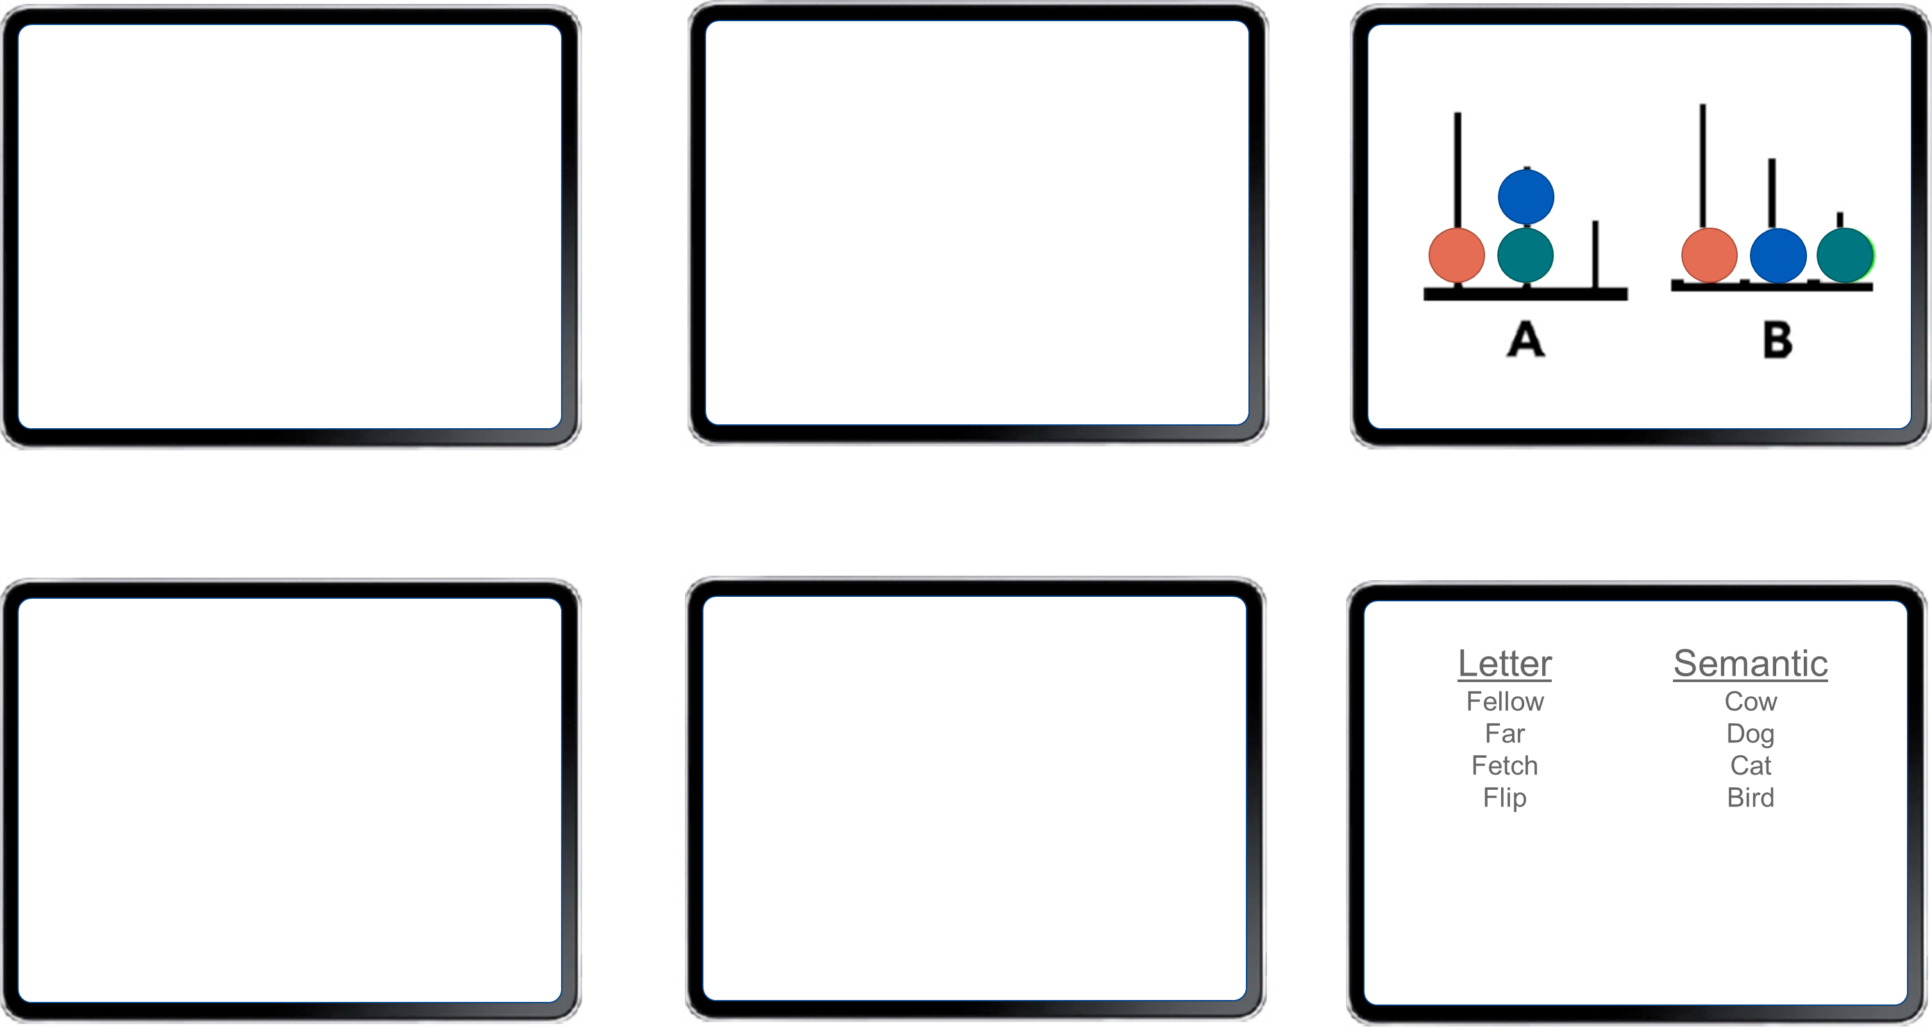
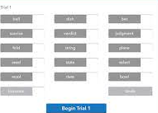
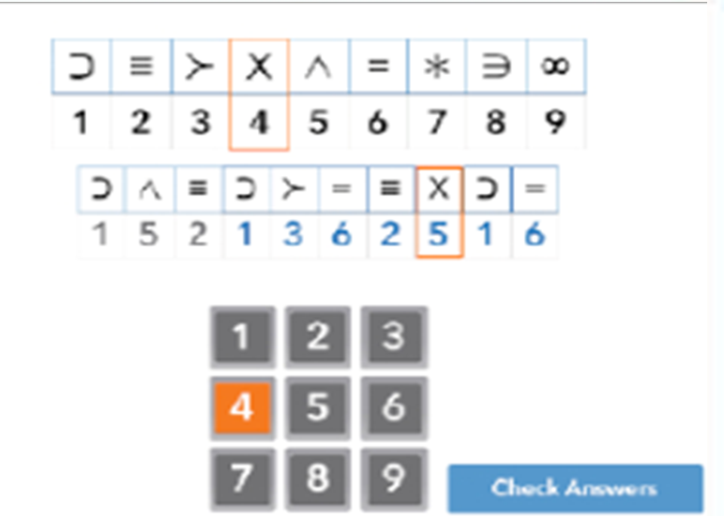
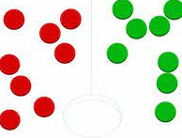
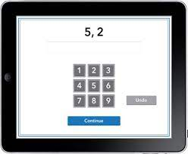

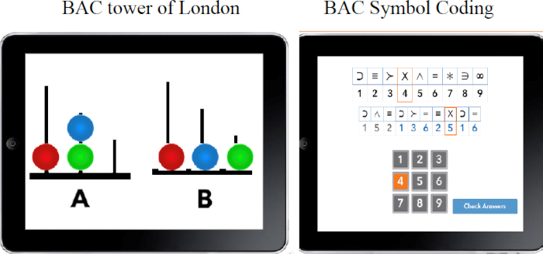

Validation of the Brief Assessment of Cognition (BAC) in multiple sclerosis
Michael Jaworski III, Curtis Wojcik, Margaret Youngs, Mahmut Unverdi, Bianca Weinstock-Guttman, Ralph Benedict
Introduction to BAC
BAC iPad Modules
The Brief Assessment of Cognition (BAC) is a standardized iPad-platform battery encompassing verbal and visual spatial memory, working memory, processing speed, verbal fluency, executive function, and hand dexterity.
The BAC is mostly automated, requiring less involvement from a technician and less administration time (30 minutes) compared to conventional neuropsychological testing (NPT).
The BAC was previously validated in healthy adults, older adults with cognitive complaints, and individuals with schizophrenia. It is currently unknown if the BAC is valid and reliable in multiple sclerosis (MS).
Verbal Memory (VM)
Symbol Coding (SC)
Tower of London (TL)
Token Motor (TM)
Digit Sequencing (DS)
Verbal Fluency (VF)
Letter
Fellow
Far
Fetch
Flip
Semantic
Cow
Dog
Cat
Bird

Slide 3
Validation of the Brief Assessment of Cognition (BAC) in multiple sclerosis
Michael Jaworski III, Curtis Wojcik, Margaret Youngs, Mahmut Unverdi, Bianca Weinstock-Guttman, Ralph Benedict
Study Objective
BAC iPad Modules
Establish convergent validity of the BAC with traditional NPT
Establish discriminative validity between disease courses in MS
Investigate test-retest reliability by readministering the BAC with subjects 1-2 weeks after baseline assessment
Establish if the BAC can discriminate between employed and unemployed MS subjects.
Verbal Memory (VM)
Symbol Coding (SC)
Tower of London (TL)
Token Motor (TM)
Digit Sequencing (DS)
Verbal Fluency (VF)

Slide 4
Validation of the Brief Assessment of Cognition (BAC) in multiple sclerosis
Michael Jaworski III, Curtis Wojcik, Margaret Youngs, Mahmut Unverdi, Bianca Weinstock-Guttman, Ralph Benedict
Methods
 |  | Relapsing Remitting (RRMS, n=29) |  | Secondary Progressive (SPMS, n=30) |  | p-value
Age (Years) |  | 48.17 (10.19) |  | 61.00 (8.24) |  | <.001
Sex (% Female) |  | 93.1% |  | 73.3% |  | .043
Education (Years) |  | 15.17 (2.32) |  | 15.07 (2.28) |  | .865
Race (% White) |  | 93.1% |  | 86.7% |  | .413
EDSS (Median [IQR]) |  | 2.0 (1.5) |  | 6.0 (2.5) |  | <.001
Disease Duration (Years) |  | 13.69 (8.86) |  | 24.03 (11.07) |  | <.001
Beck Depression-FS and Fatigue Severity Scale were non-significantly different between groups (p >.05)
A prospective analysis was performed on 29 relapsing remitting (RRMS) and 30 secondary progressive (SPMS) patients.
All were assessed at baseline with the order of assessments counterbalanced.
23 (13 RRMS and 10 SPMS) subjects were brought back 1-2 weeks later and re-administered alternate forms of the BAC.
Subjects’ employment status was assessed using the Buffalo Vocational Monitoring Survey (BVMS).
Counterbalance Order
Order A: (1) Traditional Cognitive Testing - 2) BAC App Modules
Order B: (1) BAC App Modules – (2) Traditional Cognitive Testing
BVMS asks respondents about demographics, MS disease characteristics, work status, job type, work duties, income, hours worked, and disclosure of disease status to supervisors and coworkers. It also asks about negative work events that have recently occurred (e.g., Verbal criticism) and work accommodations (e.g., flexible work hours).

Slide 5
Validation of the Brief Assessment of Cognition (BAC) in multiple sclerosis
Michael Jaworski III, Curtis Wojcik, Margaret Youngs, Mahmut Unverdi, Bianca Weinstock-Guttman, Ralph Benedict
Results
The BAC had good convergent validity, in that correlations with conventional person-administered tests were significant (Range r =.617 to r =.838, p<.001)
 | VM Total Recall 5-Trials | VMR Delayed Free Recall | DS # of Correct Sequences | TM # of Tokens Correctly Placed | SC Number Correct | TL Correct Responses | VS Total Correct Trials
9-Hole Peg Test | -.476** | -.440** | -.424** | -.659** | -.660** | -.500** | -.567**
25 Foot Walk | -.551** | -.534** | -.422** | -.615** | -.710** | -.437** | -.631**
CVLT2 Total Learning | .757** | .664** | .468** | .382** | .579** | .602** | .603**
CVLT2 Delayed Recall | .757** | .714** | .557** | .451** | .669** | .698** | .677**
BVMTR Total Learning | .723** | .645** | .510** | .598** | .713** | .716** | .727**
BVMTR Delayed Recall | .630** | .561** | .394** | .583** | .579** | .674** | .682**
SDMT Oral | .705** | .623** | .667** | .690** | .838** | .718** | .790**
DKEFS Sorting Correct Sorts | .633** | .538** | .599** | .401** | .575** | .617** | .620**
DKEFS Sorting Description Score | .622** | .504** | .590** | .373** | .550** | .629** | .578**
Bold Indicates strongest correlation with traditional neuropsychological testing
VM: Visual Memory, VMR: Visual Memory Recall, DS: Digit Sequencing, TM: Token Motor, SC: Symbol Coding, TL: Tower of London, VS: Visuospatial

Slide 6

Validation of the Brief Assessment of Cognition (BAC) in multiple sclerosis
Michael Jaworski III, Curtis Wojcik, Margaret Youngs, Mahmut Unverdi, Bianca Weinstock-Guttman, Ralph Benedict
BAC discriminated between RRMS and SPMS subjects in all previously described measures (p<.05)
Results
BAC Modules | Relapsing Remitting (n=29) | Secondary Progressive (n=28) | p-value
 | Mean (SD) | Mean (SD) | p-value
VM 1-5 Total Learning | 43.36 (7.80) | 32.07 (10.34) | <.001
VMR Delayed Recall | 8.43 (3.16) | 4.59 (3.99) | .003
DS Number of Correct Sequences | 20.03 (3.38) | 17.19 (4.10) | .002
TM Total Correctly Placed | 72.21 (26.54) | 35.11 (21.13) | <.001
VF Total Recorded | 51.59 (9.79) | 42.19 (14.13) | .003
SC Total Correct | 45.62 (10.85) | 25.96 (9.83) | <.001
TL Total Correct | 17.41 (3.73) | 13.52 (5.69) | .005
VS Total Correct | 15.55 (4.35) | 9.93 (5.05) | <.001
An ANCOVA was run to determine if BAC modules discriminate between RRMS and SPMS subjects after controlling for age.
VM: Verbal Memory
VMR: Verbal Memory Recall
VS: Visuospatial
DS: Digit Sequencing
SC: Symbol Coding
TL: Tower of London
VFT: Verbal Fluency Total
TM: Token Motor

Slide 7
Validation of the Brief Assessment of Cognition (BAC) in multiple sclerosis
Michael Jaworski III, Curtis Wojcik, Margaret Youngs, Mahmut Unverdi, Bianca Weinstock-Guttman, Ralph Benedict
Results
The BAC was found to discriminate between employed and unemployed MS subjects across disease course in all previously described measures (p<.001), with employed MS patients performing better on all measures.
BAC Modules | Employed (n=19) | Unemployed (n=29) | p-value
 | Mean (SD) | Mean (SD) | p-value
VM 1-5 Total Learning | 46.32 (7.83) | 33.11 (9.40) | <.001
VM Delayed Recall | 9.42 (2.87) | 4.89 (3.77) | .001
DS Number of Correct Sequences | 21.11 (3.37) | 17.17 (3.88) | <.001
TM Total Correctly Placed | 82.00 (18.62) | 38.90 (24.88) | <.001
VF Total Recorded | 55.79 (8.29) | 40.45 (11.40) | <.001
SC Total Correct | 50.32 (7.22) | 28.86 (12.39) | <.001
TL Total Correct | 19.11 (2.36) | 12.93 (5.49) | <.001
VS Total Correct | 17.32 (3.28) | 9.66 (4.77) | <.001
Participants were administered the BVMS to determine employment status.
10 participants reported being retired due to age and were excluded from employment related analyses.
An ANCOVA was run to determine if BAC modules discriminate between employed and unemployed MS subjects after controlling for age.
Note. VM: Visual Memory, DS: Digit Sequencing, TM: Token Motor, SC: Symbol Coding, TL: Tower of London, VS: Visuospatial

Slide 8
Validation of the Brief Assessment of Cognition (BAC) in multiple sclerosis
Michael Jaworski III, Curtis Wojcik, Margaret Youngs, Mahmut Unverdi, Bianca Weinstock-Guttman, Ralph Benedict
Results: Test-Retest Reliability
Using test-retest intra-class correlation method and paired-samples t-test, most domains provided good reliability with minimal practice effects
Domain
BAC
Baseline – M(SD)
Follow-up - M(SD)
ICC
p-value
Intra-class correlation method was employed to determine BAC module reliability after a 1–2-week follow-up
Paired samples t-tests were conducted to identify any potential practice effects.
VM: Verbal Memory
VMR: Verbal Memory Recall
VS: Visuospatial
DS: Digit Sequencing
SC: Symbol Coding
TL: Tower of London
VFT: Verbal Fluency Total
TM: Token Motor
Verbal Learning
VM
40.83 (9.66)
41.22 (9.73)
.74
.792
Verbal Recall
VMR
7.30 (3.90)
8.13 (3.31)
.86
.062
Visuospatial Memory
VS
12.91 (4.61)
14.87 (4.57)
.69
.017
Working Memory
DS
18.78 (4.1)
19.91 (3.5)
.71
.834
Processing Speed
SC
38.22 (11.80)
41.52 (15.69)
.92
.029
Executive Function
TL
15.91 (4.94)
16.48 (3.00)
.49
.537
Verbal Fluency
VFT
47.65 (10.13)
47.91 (8.58
.84
.822
Hand Dexterity
TM
56.17 (26.58)
56.09 (30.54)
.88
.978

Slide 9
Validation of the Brief Assessment of Cognition (BAC) in multiple sclerosis
Michael Jaworski III, Curtis Wojcik, Margaret Youngs, Mahmut Unverdi, Bianca Weinstock-Guttman, Ralph Benedict
Disclosures
Mahmut Unverdi, Curtis Wojcik, Michael Jaworski III, and Margaret Youngs: nothing to disclose.
Bianca Weinstock-Guttman has participated in speaker's bureaus and/or served as a consultant for Biogen, EMD Serono, Novartis, Genentech, Bristol Myers Squibb, Abbvie, Sanofi Genzyme and Mallinckrodt. Dr. Weinstock-Guttman also has received grant/research support from the agencies listed in the previous sentence. She serves on the editorial board for BMJ Neurology, Children, CNS Drugs, MS International and Frontiers Epidemiology.
Ralph Benedict received honoraria, speaking or consulting fees from Biogen, Bristol Myers Squibb, EMD Serono, Genentech, Medday, Novartis, and Roche, and has received research support from Biogen, Genentech, and Novartis.
This project was sponsored by Verasci

